Slide 1

Developing R coding resources for upper-division undergraduate coursework
James Vesto, Danielle Cass, Juliane Fry
Reed College, Portland, OR
March 24th, 2020
Notes:
Hi, my name is James Vesto and I am a Junior Chemistry Major at Reed College in Portland Oregon and I am here to talk to y’all about a programming language called R. R is an open source statistical programming language that has similar functions and applications to Excel, and over the course of this past semester I worked with Professors Julie Fry and Danielle Cass to develop an R protocol for Chem 311: Analytical Chemistry. Which is a required course for chemistry majors primarily taken by juniors and seniors, as well as a handful of sophomores.

Slide 2


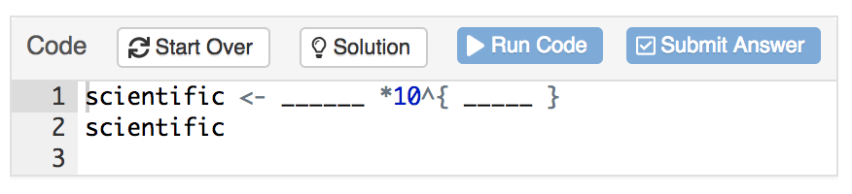
The Chemistry R Workbook
https://shiny.reed.edu/s/users/vestoj/chemistry/
Topic is explained
Exercise Example:
Store .0345 in scientific notation. Replace the blanks with the answer in the code chunk.
(ex. scientific <- 2.345*10^{-2})
Example provided
Assessment
Automatic feedback
Automatic Feedback Process:
Correct Answer
“Great Job!”
Convert number to scientific notation
Student deleted R code
"Make sure not to get rid of code when you enter the values"
Student replicates example
Incorrect answer
Incorrect conversion
"Try again, make sure output is equal to the starting value"
Notes:
R was first implemented in general chemistry at Reed in 2015 and in the summer of 2017, I worked with Danielle Cass and Natasja Swartz to develop an interactive coding workbook that provides students with automatic feedback on introductory chemistry specific exercises. This workbook was implemented that fall and is still the primary method used to expose Reed chemistry students to the programming language with the additional support of lab report templates.

Slide 3
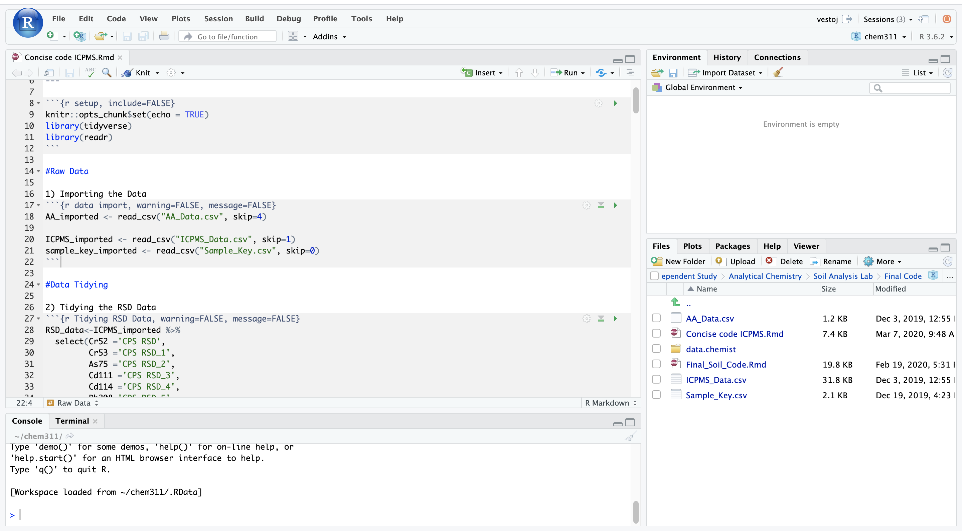
Notes:
The primary goal of using R in upper division courses such as analytical chemistry is to bridge the gap between raw data and scientific results. R and its interface RStudio allow students to write efficient code for data analysis that is highly reproducible, and it being an open source language allows students to continue to utilize the code after graduation regardless of financial limitations.

Slide 4
The Johnson-Creek Watershed Project.
Environmental Sampling
Sample Preparation:
Acid Digestion
Instrumental Analysis:
FAAS & ICPMS
Raw Data
Results
How can we turn data into reproducible scientific results?
Notes:
In Chem 311, one of the major projects that students work on is analyzing heavy metal concentrations in a local watershed, that is predicted to have experienced some contamination from industrial zones. Students begin by developing an environmental sampling procedure which they use to collect soil samples at different sites along the creek. After procuring the samples, they work in lab to perform an acid digestion and prepare the soil for instrumental analysis. The samples were analyzed both via flame atomic absorption spectroscopy as well as inductively coupled plasma mass spectroscopy in collaboration with Oregon Health and Science University. Once the data has been collected comes my favorite part, turning that raw data into scientific results.

Slide 5
The process of data analysis
Raw Data
Results
Tidy Data
Calibration and Data Analysis
Statistical Analysis and Error Propagation
Data Visualization
Notes:
The process of data analysis that we are implementing in the course begins by wrangling the raw data into tidy data using an R package called the Tidyverse. By tidying the data students are able to write calibration and data analysis functions that can be easily reused if and when the data is replicated. Next they are able to perform statistical analysis and error propagation which allows an opportunity for them to think critically about the precision of each step within the sample preparation. Finally, the students are able to create unique data visualizations that tell a story about the scientific results and these figures, alongside the code, are included in the write-up of the report.

Slide 6
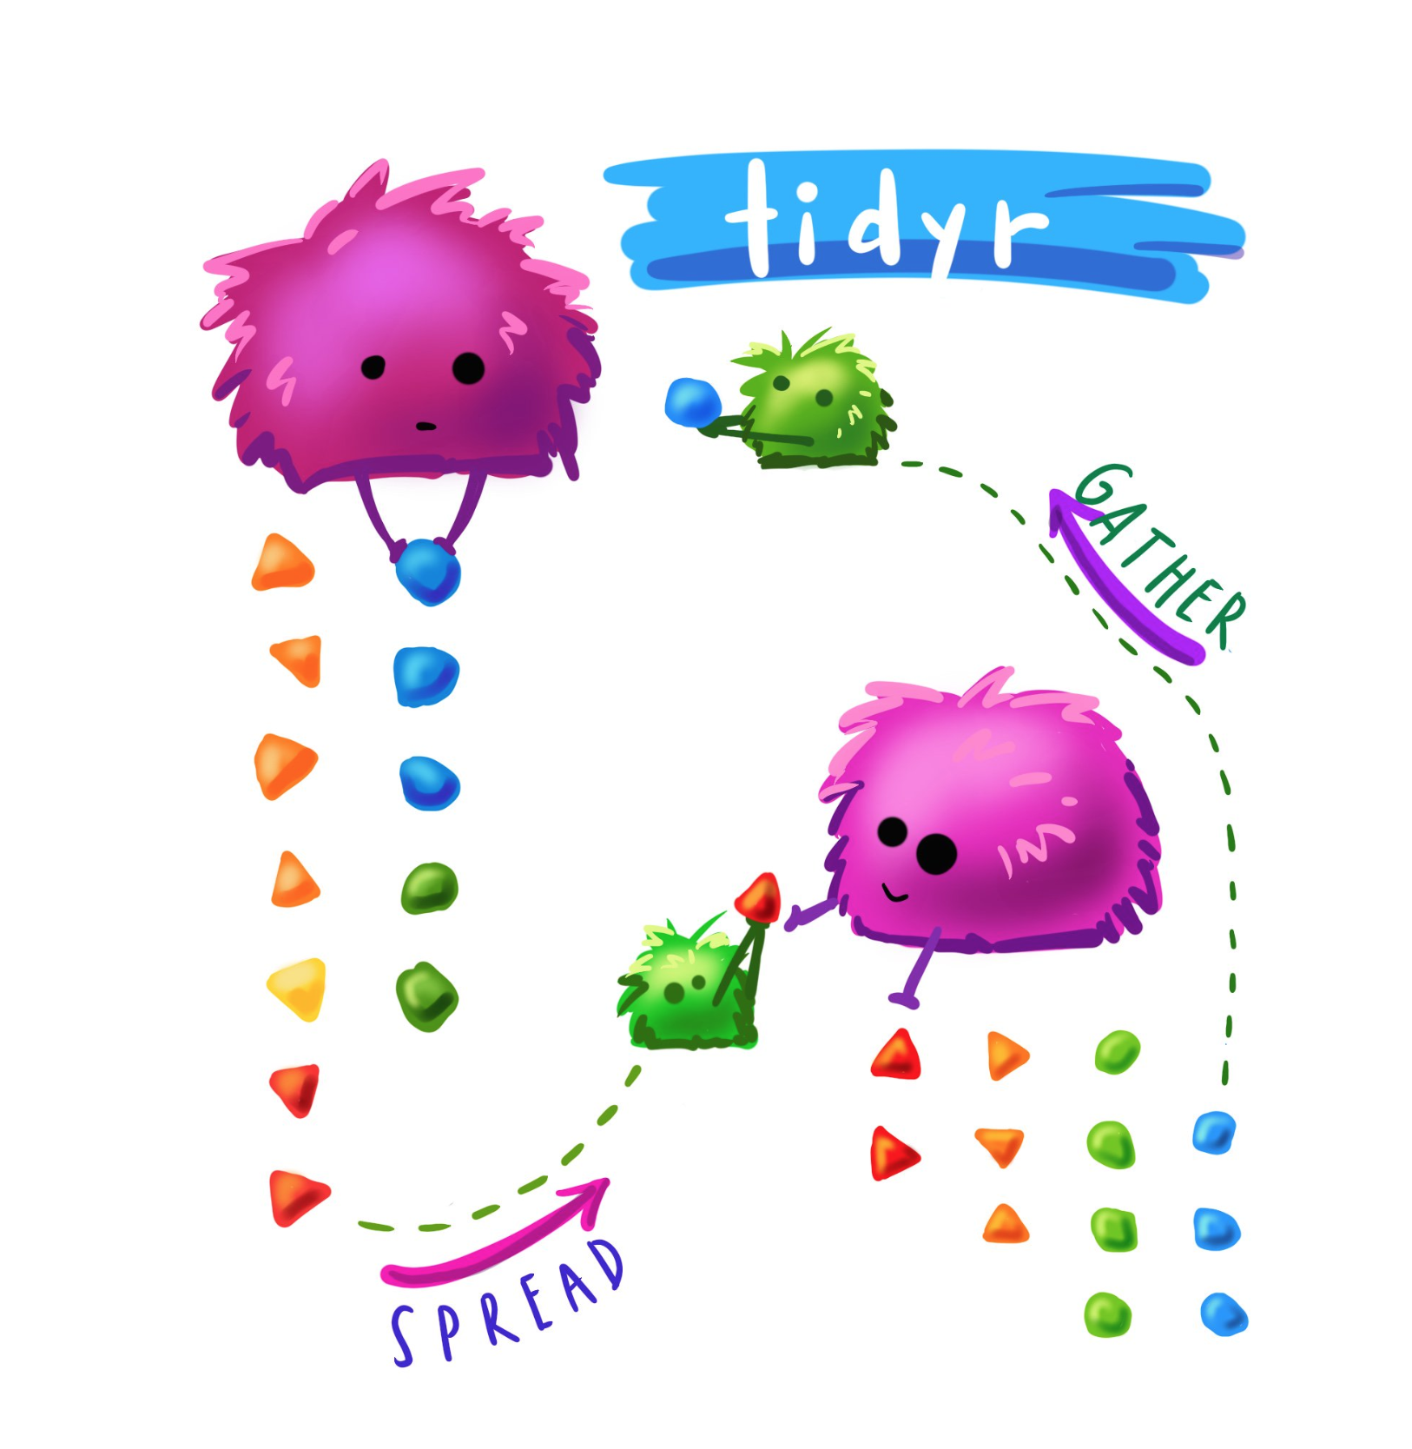
The Language of R: Vocabulary
Tidyverse functions:
select
mutate
gather
rename
merge
Allison Horst: RStudio Artist in Residence
Notes:
Similarly, to learning a spoken language, there are two main aspects of learning how to code, the first of which is being able to recognize the vocabulary. The vocabulary of R is primarily shared in the form of packages which are collections of functions, data and compiled code. The main package used within the Johnson creek watershed project is called the Tidyverse, which is a coherent system of packages for data manipulation, exploration and visualization which was created by Hadley Wickham who is currently the chief scientist at R-Studio.

Slide 7
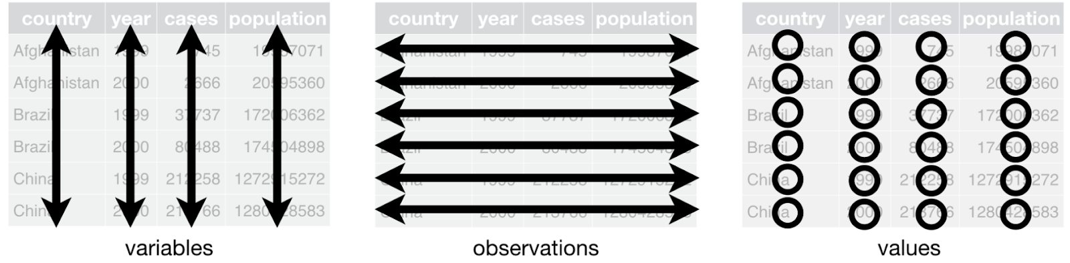
Elements of Tidy Data
Credit: Hadley Wickham: RStudio Chief Scientist
Notes:
The main philosophy of the Tidyverse begins with an organizational system known as tidy data.
Tidy data follows three interrelated rules:
first each variable must have its own column,
second each observation must have its own row,
and third each value must have its own cell.

Slide 8
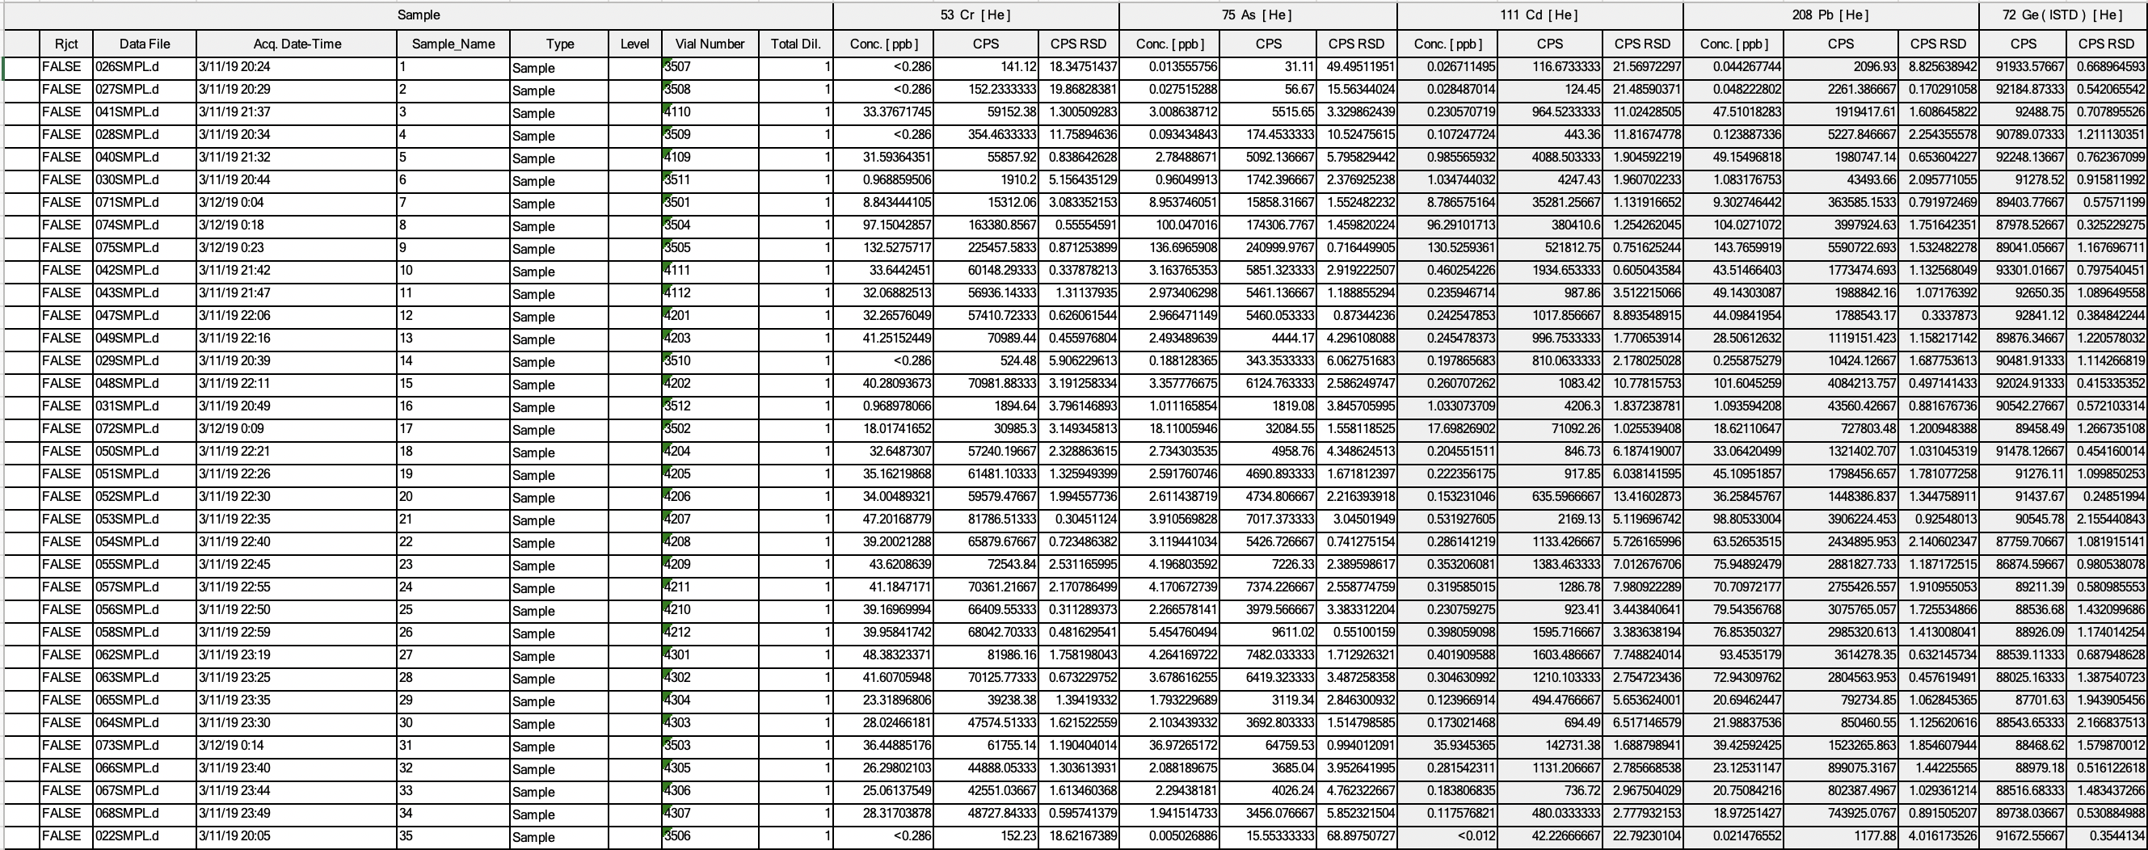
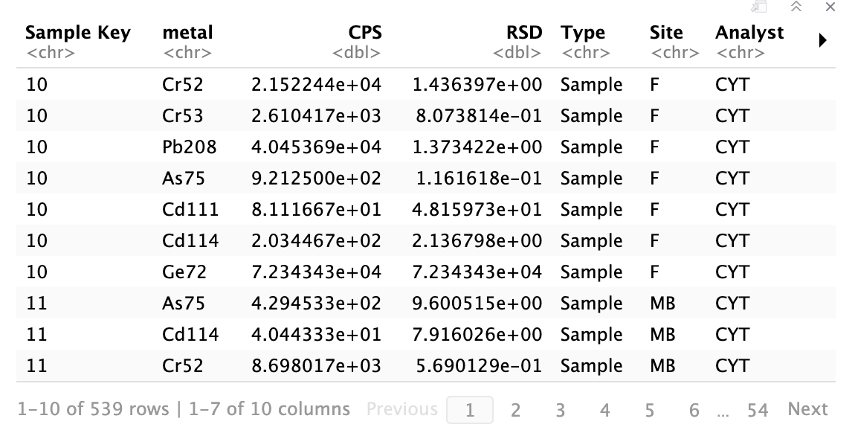
Elements of Tidy Data
Raw Data
Tidy Data
Notes:
In exchange for following this set of rules, it allows for a coherent workflow and increases the reproducibility of the code. Although it can seem tedious to dedicate a significant portion of the analysis to simply formatting the data, it allows for students to work with increasingly larger datasets and as students become more familiar with data wrangling the task becomes efficient as they are able to correctly utilize a greater number of functions that replace mundane wrangling steps.

Slide 9
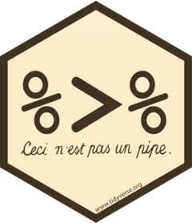
The Language of R: Grammar
function(input){
code}
for(var in data){
code}
pipe
function
for loop
Notes:
The second main aspect to learning how to code is being able to implement the grammar of the language. The data analysis procedure for the Johnson Creek Watershed Project teaches three main grammatical constructs that were not previously introduced during general chemistry. These are pipes, function writing, and for loops.

Slide 10
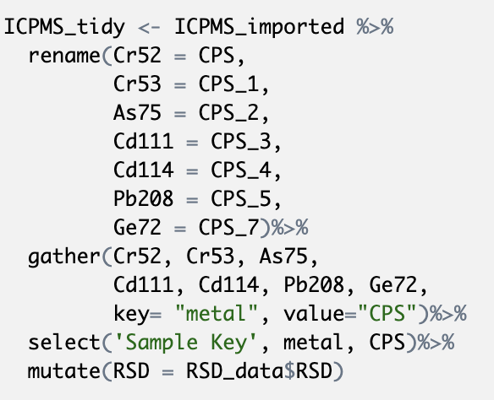
The pipe: %>%
variable <- Data %>%
function(input)%>%
function2(input)
pre_variable <- function( data = Data, input)
variable <- function2(data=pre_variable, input)
Notes:
Pipes are primarily used during the data tidying portion of the analysis and allow for multiple functions to be applied to a single dataset without needing to continuously store new variables for each data manipulation. The pipe works within the code by passing the data into the next function.
Each variable stored, clutters your RStudio environment, and can lead to error messages, copying and pasting mistakes, or confusion in which the wrong data is used and alters the results.

Slide 11
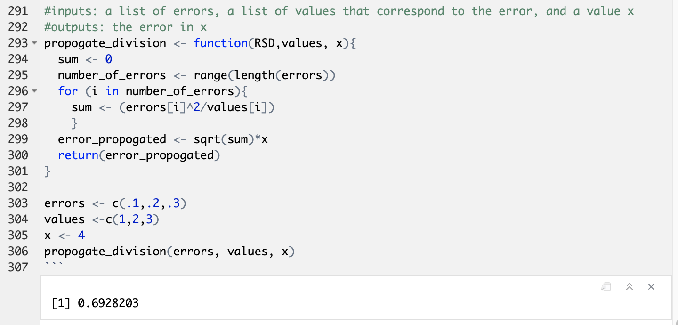
Function Writing
Notes:
Functions allow data processing to be applied multiple times with different inputs and is an alternative to repeatedly copying and pasting analyses. The main benefit of writing functions is that they allow for the most reproducible form of code. A researcher could write a set of functions that preform common data analyses used within their lab and turn the functions into an R package that allows for collaboration and consistent data analysis, similarly to writing a standard operating procedure. Although the scope of the watershed project does not necessarily require the use of novel functions, teaching students how to develop and implement this greatly improves the applicability of their coding skills.

Slide 12
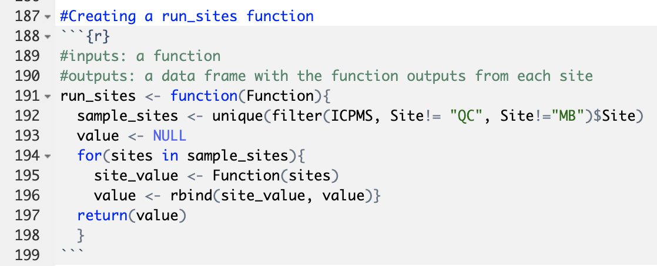
For Loops
Notes:
For loops allow an analysis to be repeated a set number of times. In the watershed project there are multiple instances in which a data analysis procedure must be applied, while sorting by a list of variables. For instance, it is necessary to perform a calibration for each metal being tested, however aside from the metal the iterations are identical and a for loop can be used to consolidate the code. A function is not as useful in this case because the function would need to be re-ran for each metal which requires additional copying and pasting. However, if the analysis is to be replicated on future data then the for loops can be implemented within a function.

Slide 13
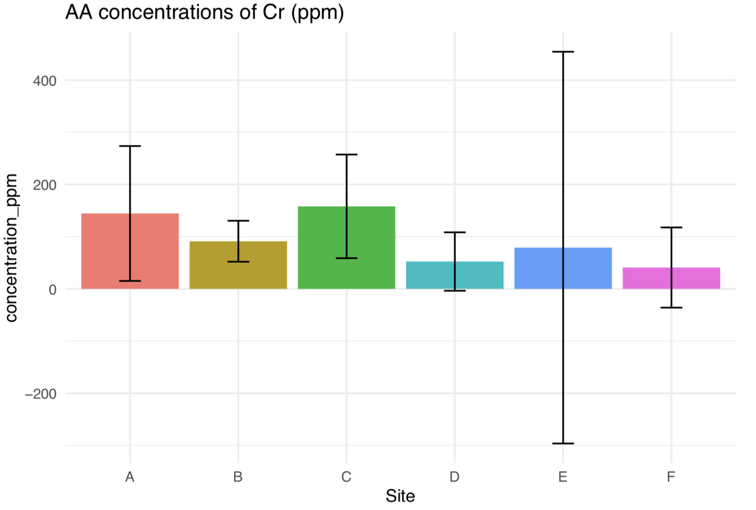
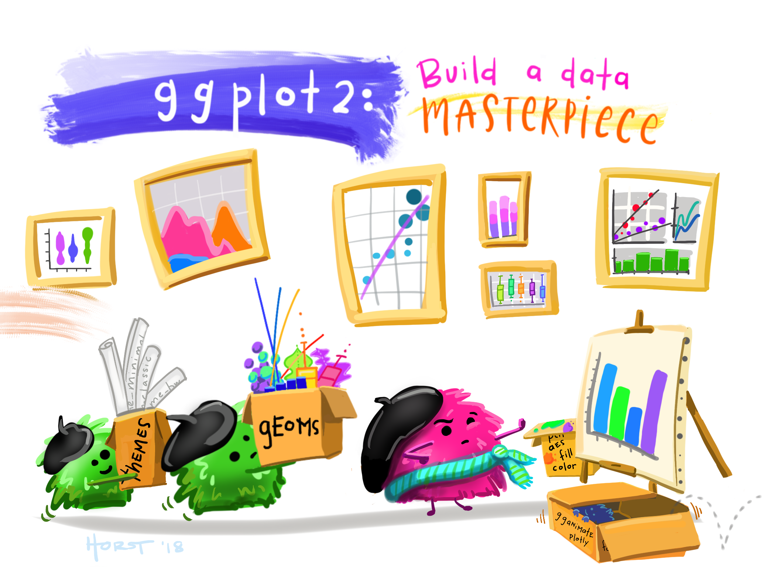
Data Visualization
Allison Horst: RStudio Artist in Residence
Notes:
In addition to learning the grammar and vocabulary necessary for the Johnson creek watershed project, students are provided an opportunity to get creative and showcase their data visualization skills. Most, if not all, students at this point in chem 311 have some experience preforming data visualization in R from previous assignments within the course, and the work they have completed to reach this point of the analysis gives them a tidy data-set consisting of the concentrations of each metal at each site as well as the uncertainty in the value and any statistical information that they may have calculated to compare results.

Slide 14


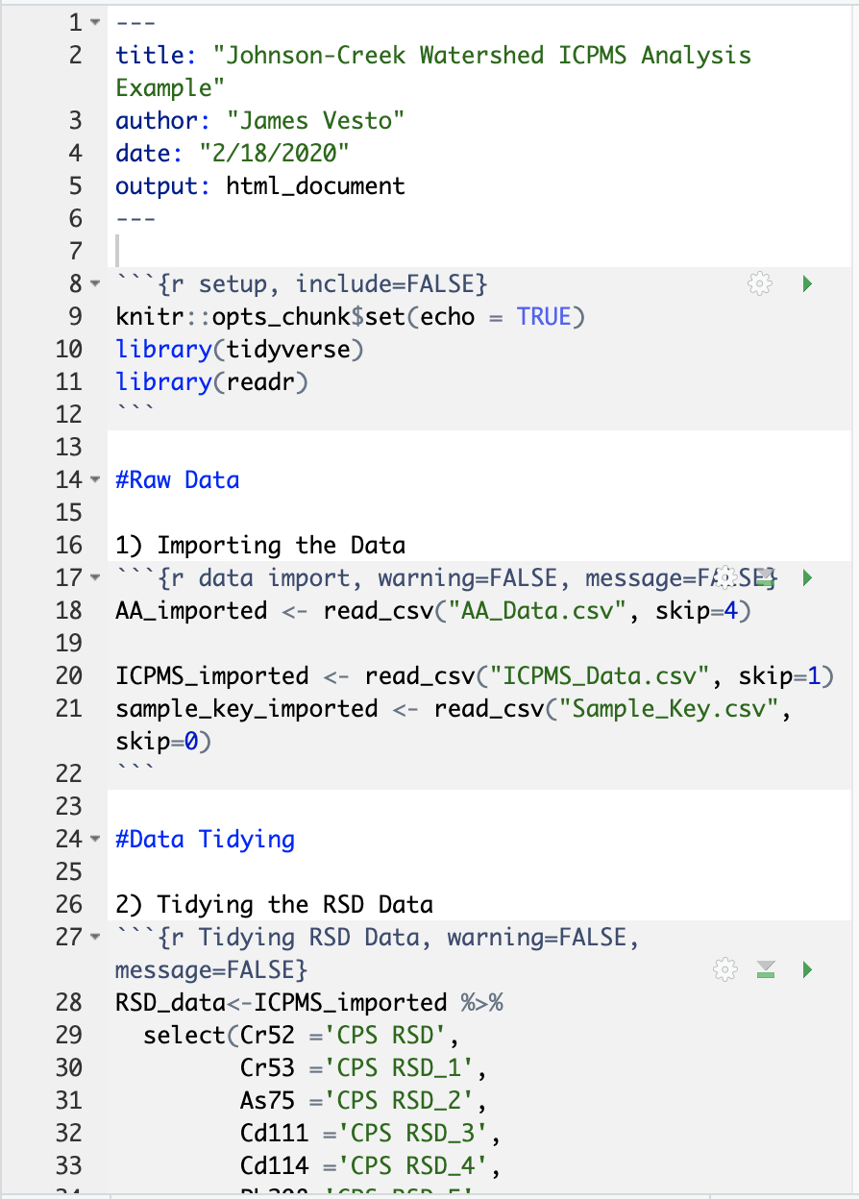
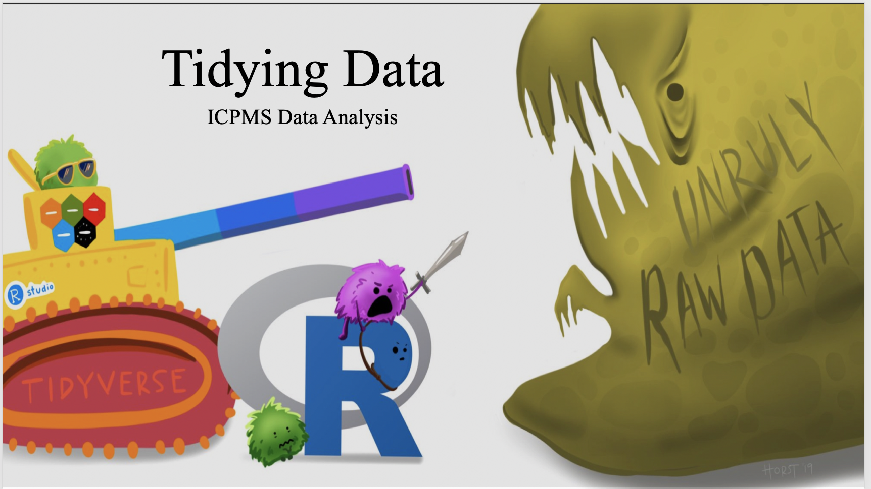
How was this project implemented?
Example provided
Student replicates example
Student extrapolates from example
Notes:
The coding skills required for the project were presented in the form of an hour-long data tidying workshop ran during a lecture timeslot. As well as in the form of an example code file that students were able to copy paste into their own analysis. This file included many of the data analysis functions for the ICPMS data but did not include portions on error propagation, statistical analysis and data visualizations. Due to the simpler format of the flame atomic absorption spectroscopy data, students were also tasked with extrapolating from the ICPMS code to fit the data tidying and analysis required by FAAS.

Slide 15




Practicalities and Next Steps
Lessen Workload
Develop R Package
Draft Manuscript
Re-implement in Fall 2020
Notes:
One of the main practicalities of the Johnson Creek Watershed project, is that it requires a larger quantity of code than students are used to writing, as well as a host of new skills to be developed and a plethora of errors to resolve. Going forward we are looking into ways to decrease the workload of the project without lessening the skill set students will develop.
This past semester we worked to design a data analysis procedure in real time with the project being performed and going into next semester we have an additional advantage of being able to look retrospectively at the code and consolidate as needed. The next steps for the project include the possibility of designing an R package that would be widely accessible to students at Reed as well as within the larger chemistry community and would include example code and functions based off the Johnson-Creek watershed project. In addition, we are working on writing a paper to document this coding experience and procedure which would be an additional resource for students in chem 311 to utilize during the project as well as to share more details around using R for data analysis within the chemistry community.

Slide 16

Acknowledgements
Reed College Analytical Chemistry: Class of 2019
OHSU Elemental Analysis Core: Dr. Martina Ralle
Reed College Computer User Services
Github: @vestoj
Email: jamesvesto@gmail.com,
jfry@reed.edu,
dcass@reed.edu
Notes:
Acknowledgements (Not quite sure what is appropriate to say here).
Feel free to contact me if you have any additional questions, and my contact information is listed here. Thank you.
Thanks for watching my presentation, please feel free to reach out to me with any questions!
Remove Ind. Stud. Adv.
Add email address

